Slide 1
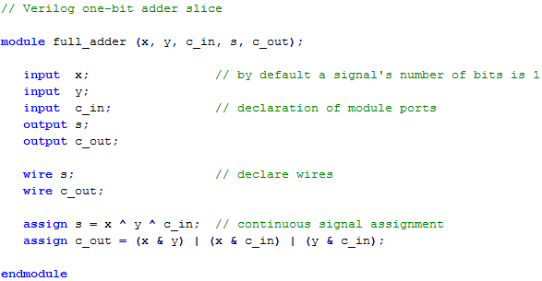
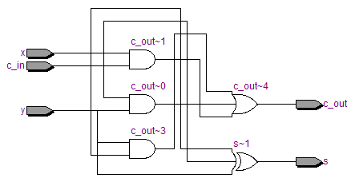

Slide 2
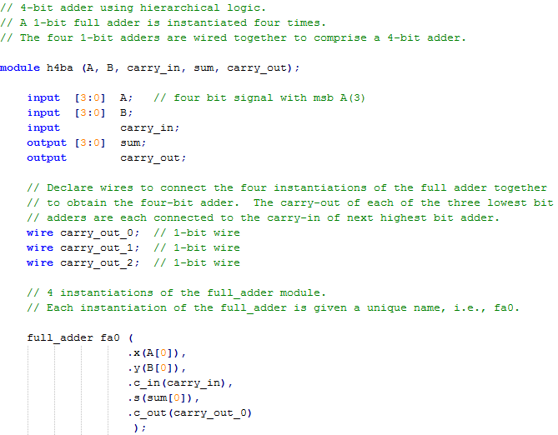
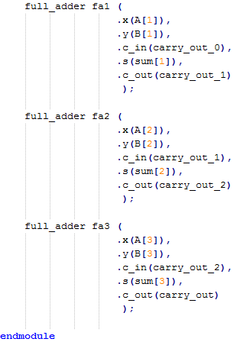
each of these is an instantiation of “full_adder”

Slide 3
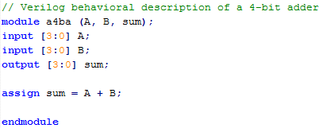
Verilog compilers will replace arithmetic operators with default logic implementations (e.g. ripple carry adder)
this expands into logic for a ripple carry adder

Slide 4
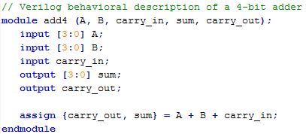
{ …, …, …} used for “concatenation” of signals.
If #bits on left and right sides are different, then truncation or “0” extension is performed accordingly.

Slide 5
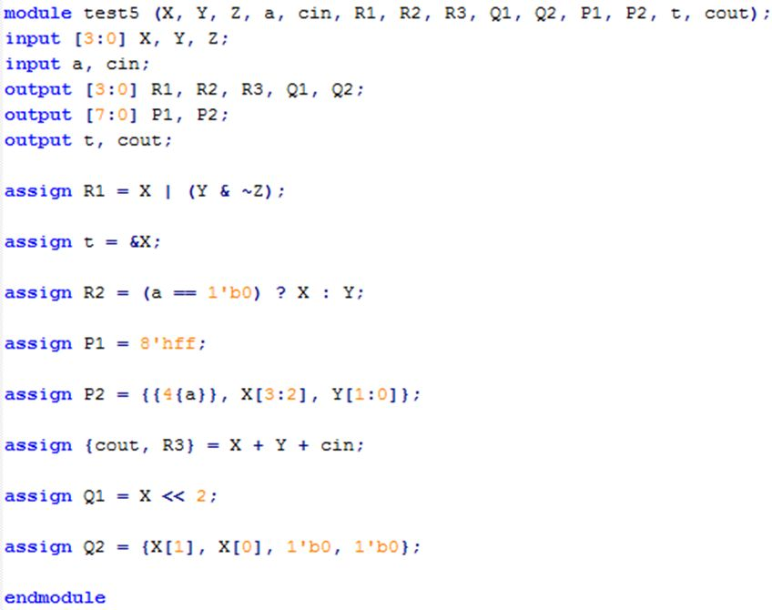
use of bitwise Boolean operators
example reduction operator
conditional operator
example constants
replication, same as {a, a, a, a}
example concatenation
bit shift operator
equivalent bit shift

Slide 7
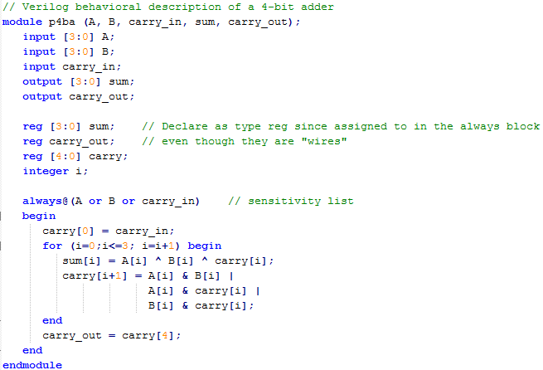
any variable written to in an always stmt must be declared as a reg, incl. outputs
entire “always” block is called an “always statement”. “signals” going into the always statement should be specified on the “sensitivity list”.
for loops must have a specified range. simply interpreted as “replication”.
Verilog calls the use of “=“ inside an always statement as a “blocking” assignment. all it means is that the Verilog will “parse” the lines of code inside the always block in “sequential” order in the generation of logic. (will make more sense later when we discuss “non-blocking” assignments.)

Slide 8
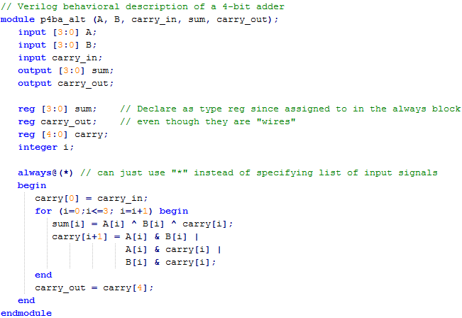

Slide 9
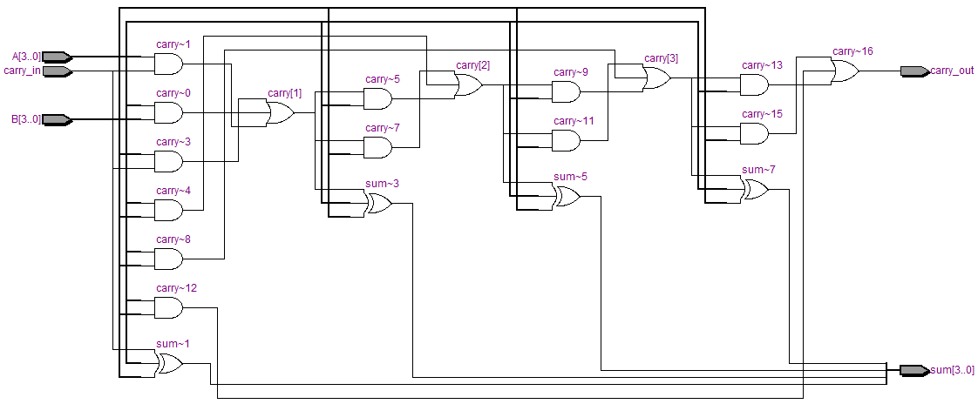

Slide 10
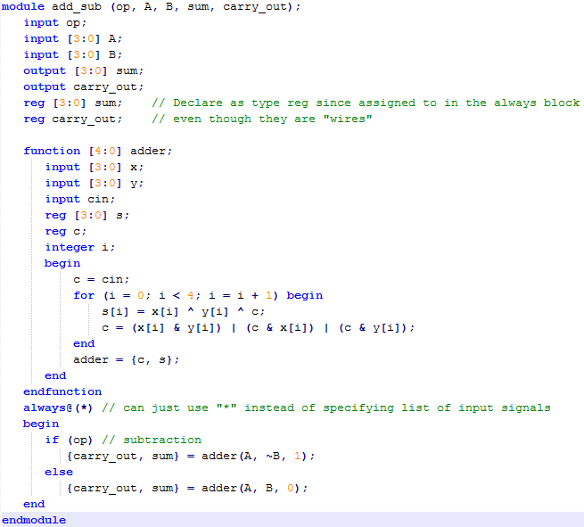
functions describe a block of logic
function calls simply logic replacement.
if-then-else statements replaced by MUX (same with case statements, later described)

Slide 11
